Slide 1
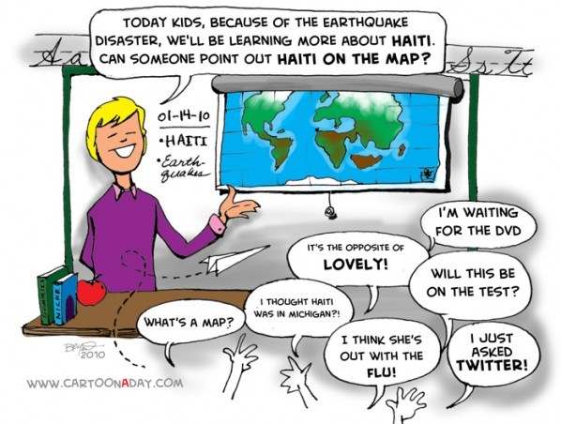
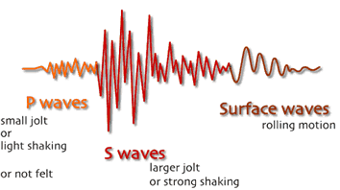
Pymaseis
An Application for Educational Seismology

Slide 2
Overview
Motivation for doing the project
Existing solutions
Proposed Solution
Current Progress
Demo
Challenges
What’s Next

Slide 3


Motivation
Raise awareness about the Dynamic Earth through Educational Seismology
Teach seismology in schools throughout USA and NZ
Sharing seismic data with other schools
TC1 seismometer provided to schools

Slide 4

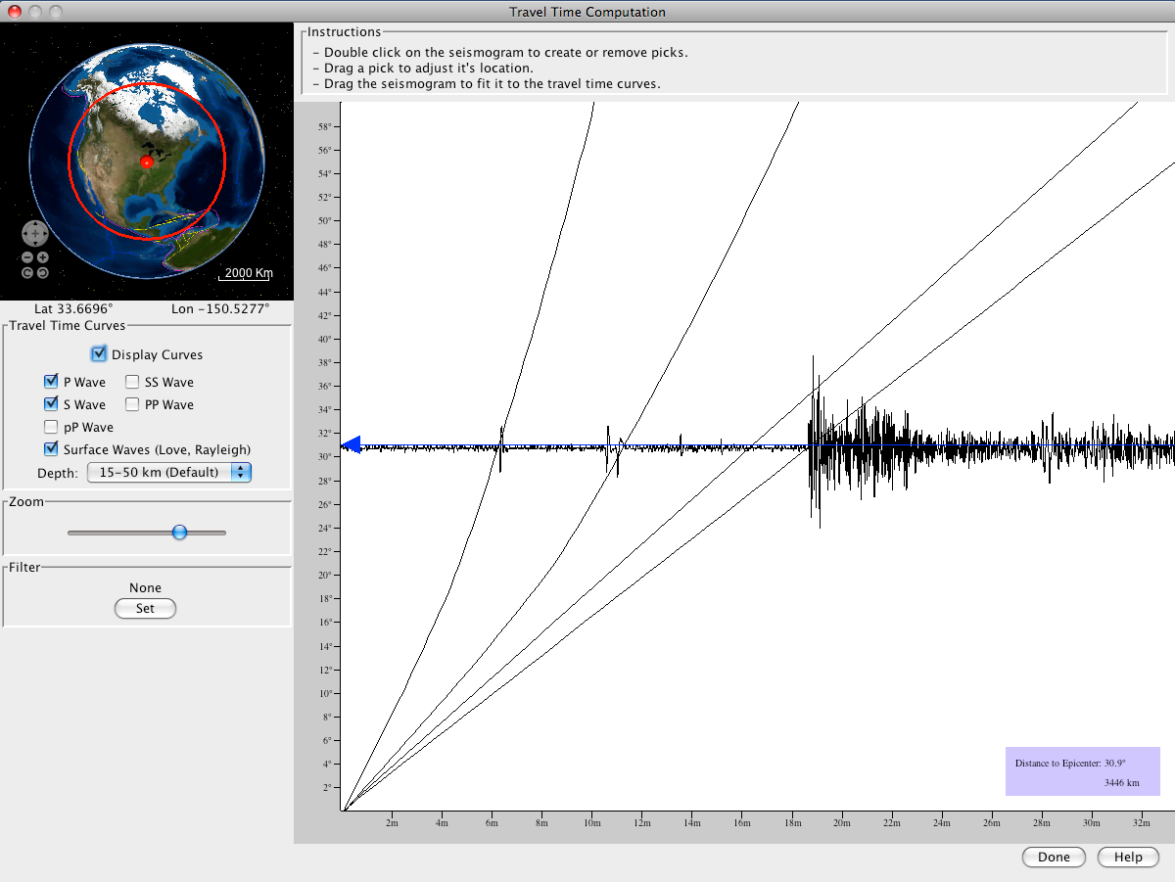
Existing Solutions
Primary focus is not for teaching seismology
Built for professionals
Complicated to use
Most high level functionality is not required for purpose

Slide 5


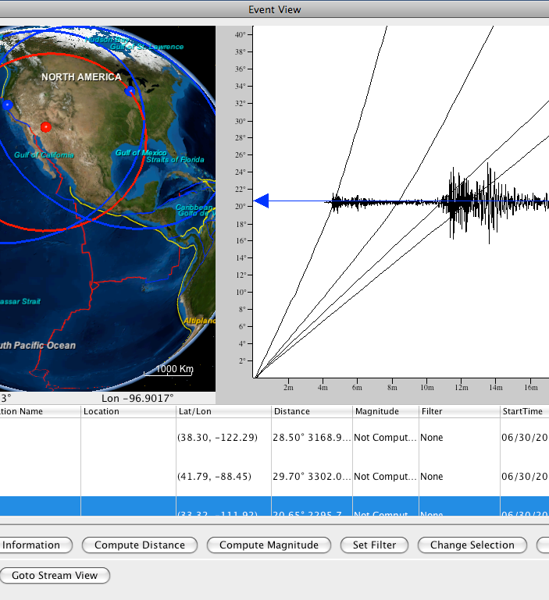


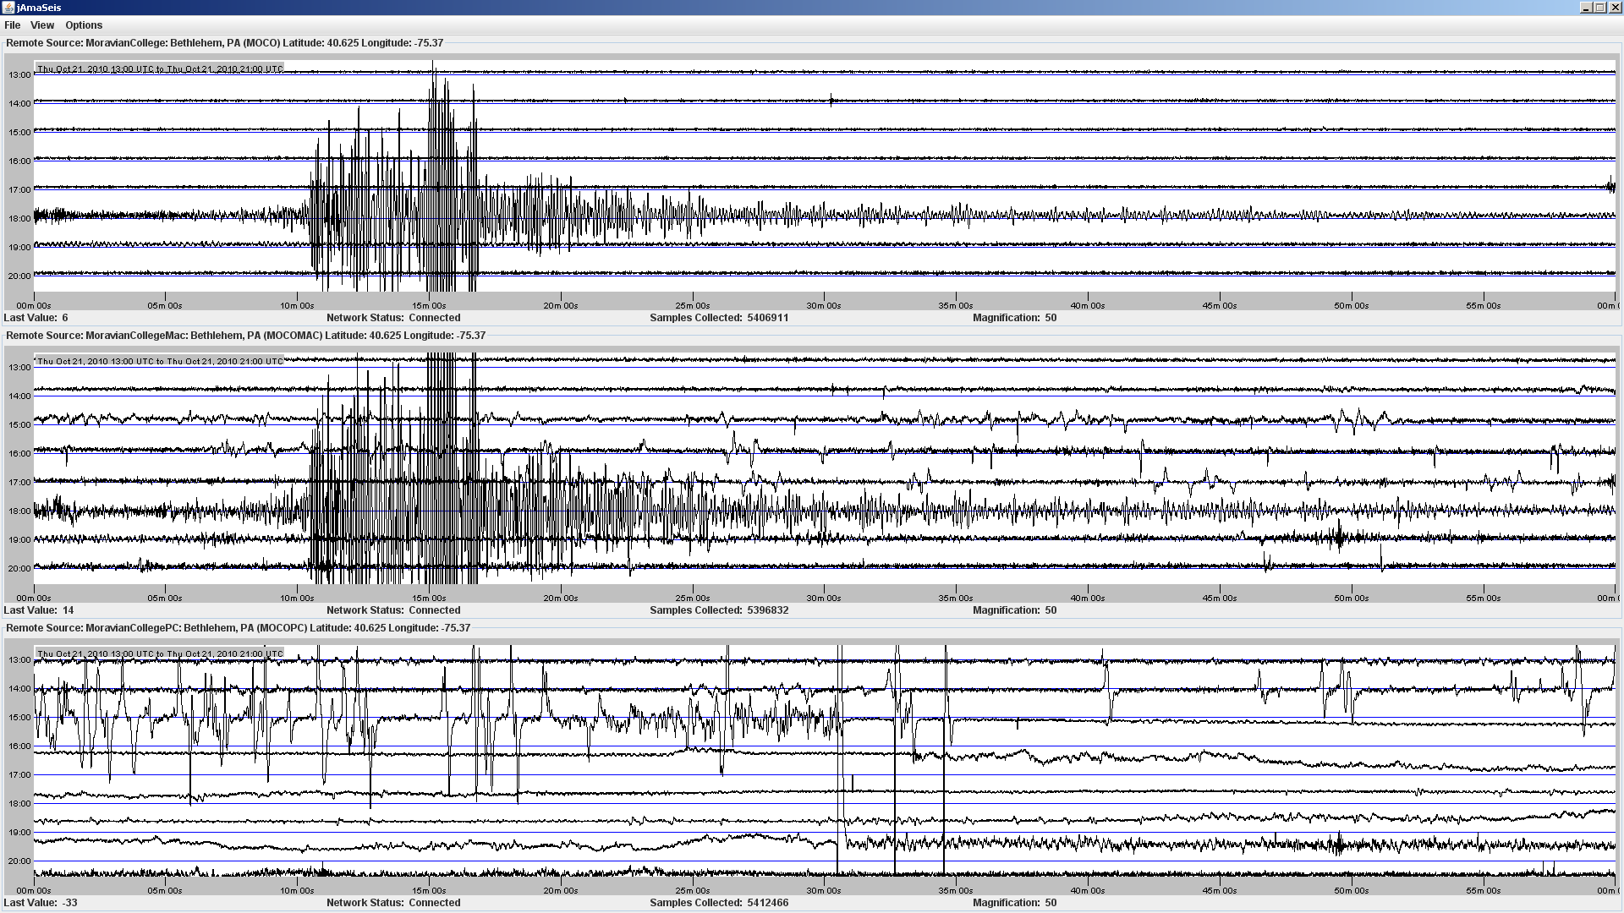

Slide 6
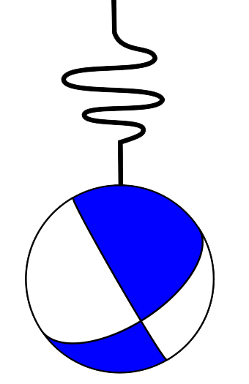
Solution
Simple and Intuitive Interface
Accurate
Essential Functionality
Collects, Processes, Displays and Shares Earthquake signals with other schools online
Robust
User-Friendly
Pymaseis

Slide 7
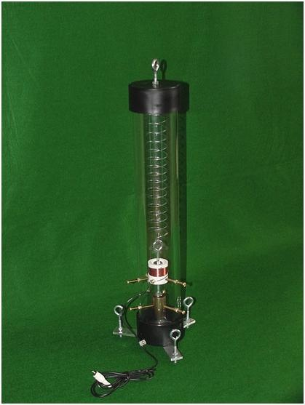



Learning Environment
Pymaseis
TC1 Seismometer

Slide 8
Pymaseis Core Features
Reading (from TC1 seismometer)
Processing (decoding, casting)
Displaying (Live Plotting)
Saving (mseed)
Sharing (Seedlink Server)

Slide 9
Pymaseis Extra Features
Zoom in/out on plot
Save selected part of a plot as an mseed
Automatic Screenshots of the plot
Set custom x (minutes) and y (hours) axis

Slide 10
Technologies, Services and Devices
Python 2.7
ObsPy 0.92
Matplotlib 1.3.1
GNUPlot 4.6.2
TC1 educational seismometer
Seedlink Plotter
Seedlink Server
jAmaseis 1.00.0
GitHub
tKinter 3.3.5

Slide 11
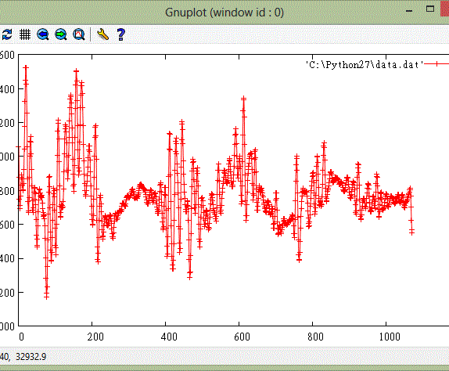
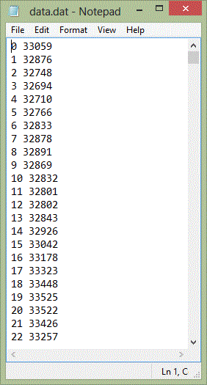
Pymaseis v0.1
Read data from TC1 via serial port
Save data in .dat
Stop python script with ctrl+c
Plot data in GNUPlot at the end

Slide 12
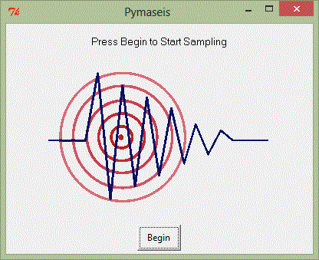
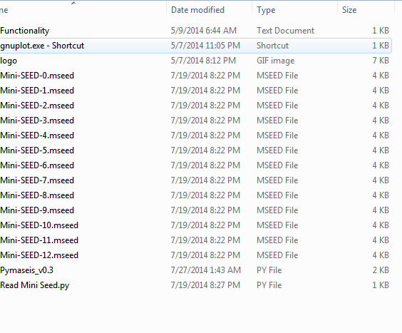
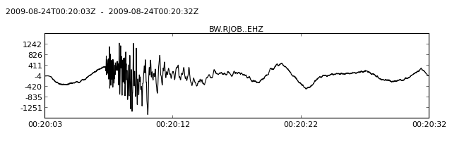
Pymaseis v0.2
Basic GUI
Saving data into mseed
Plot each trace after saving it (Static Plot)

Slide 13
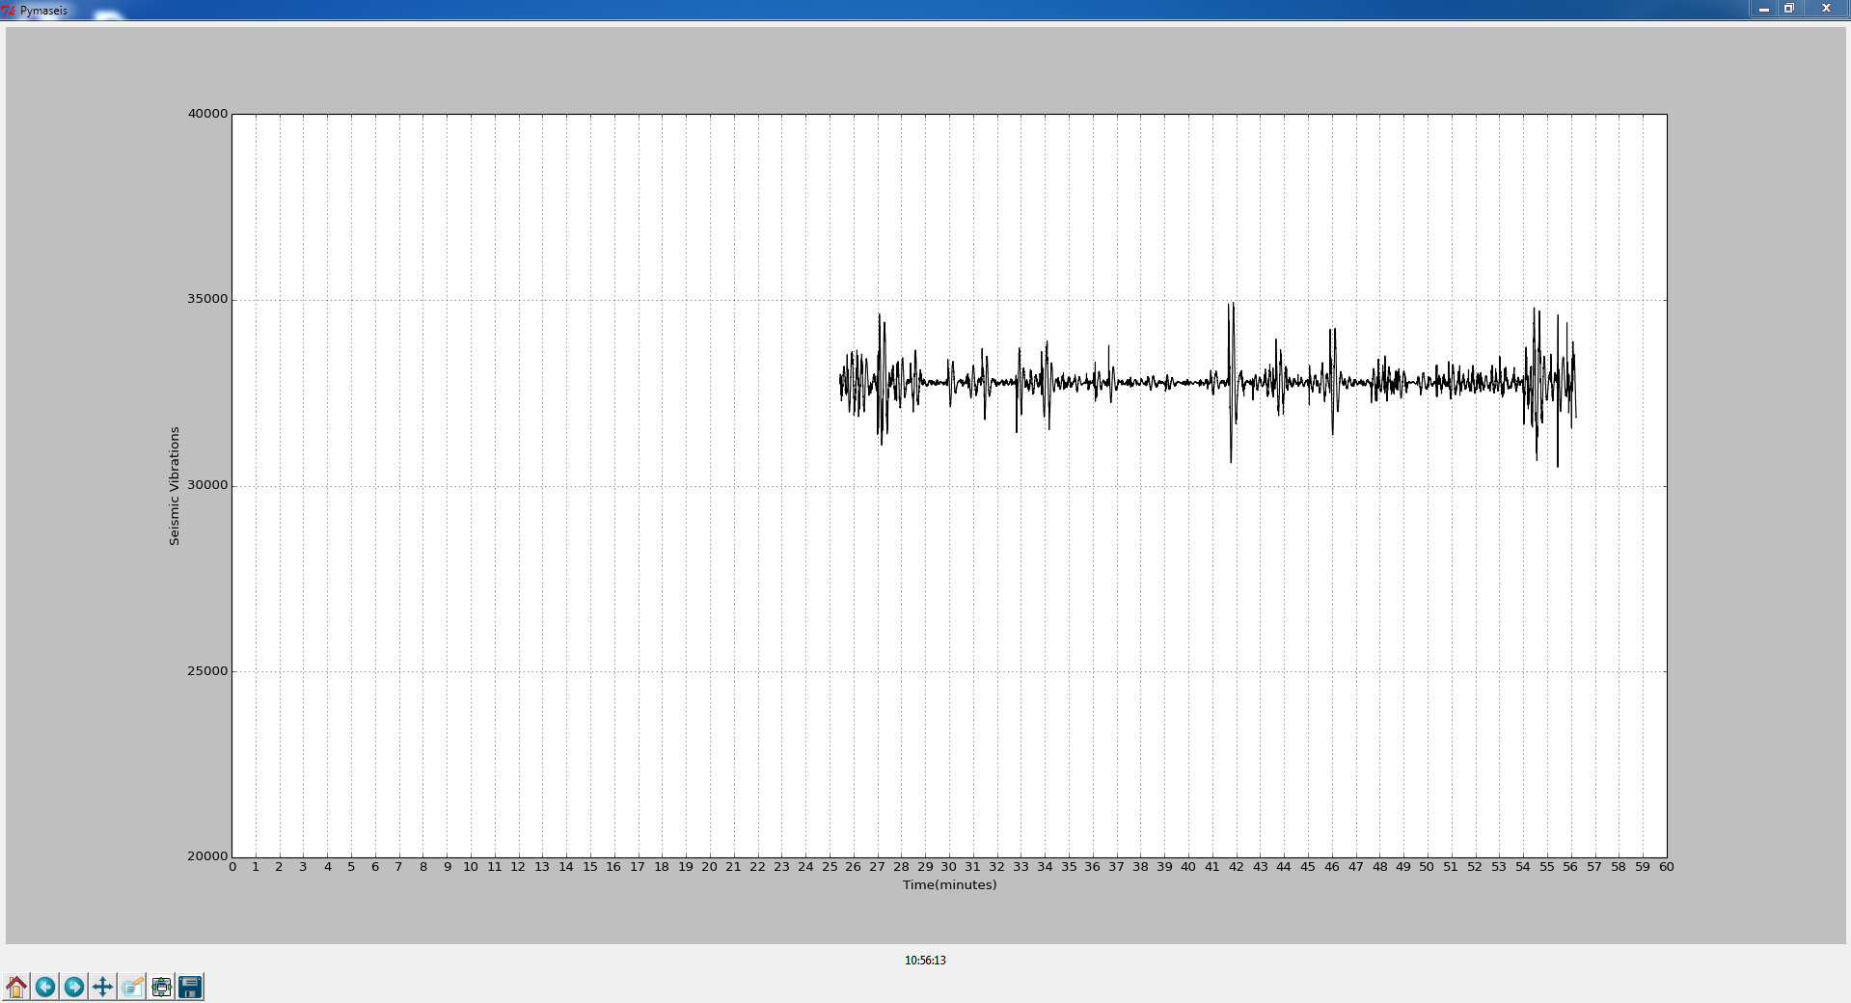
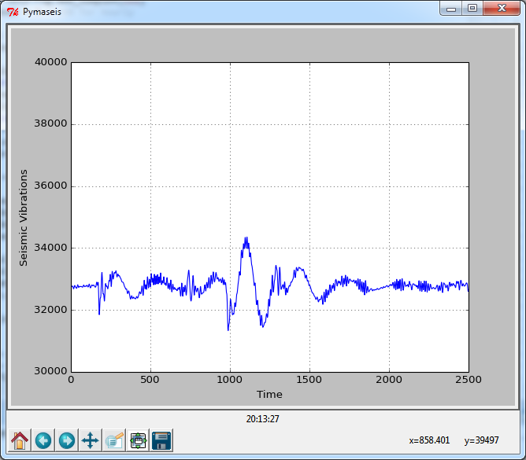
Pymaseis v0.3
Displaying Live data
Calibrating x and y axis and labels
Multiple subplots on main plot

Slide 14
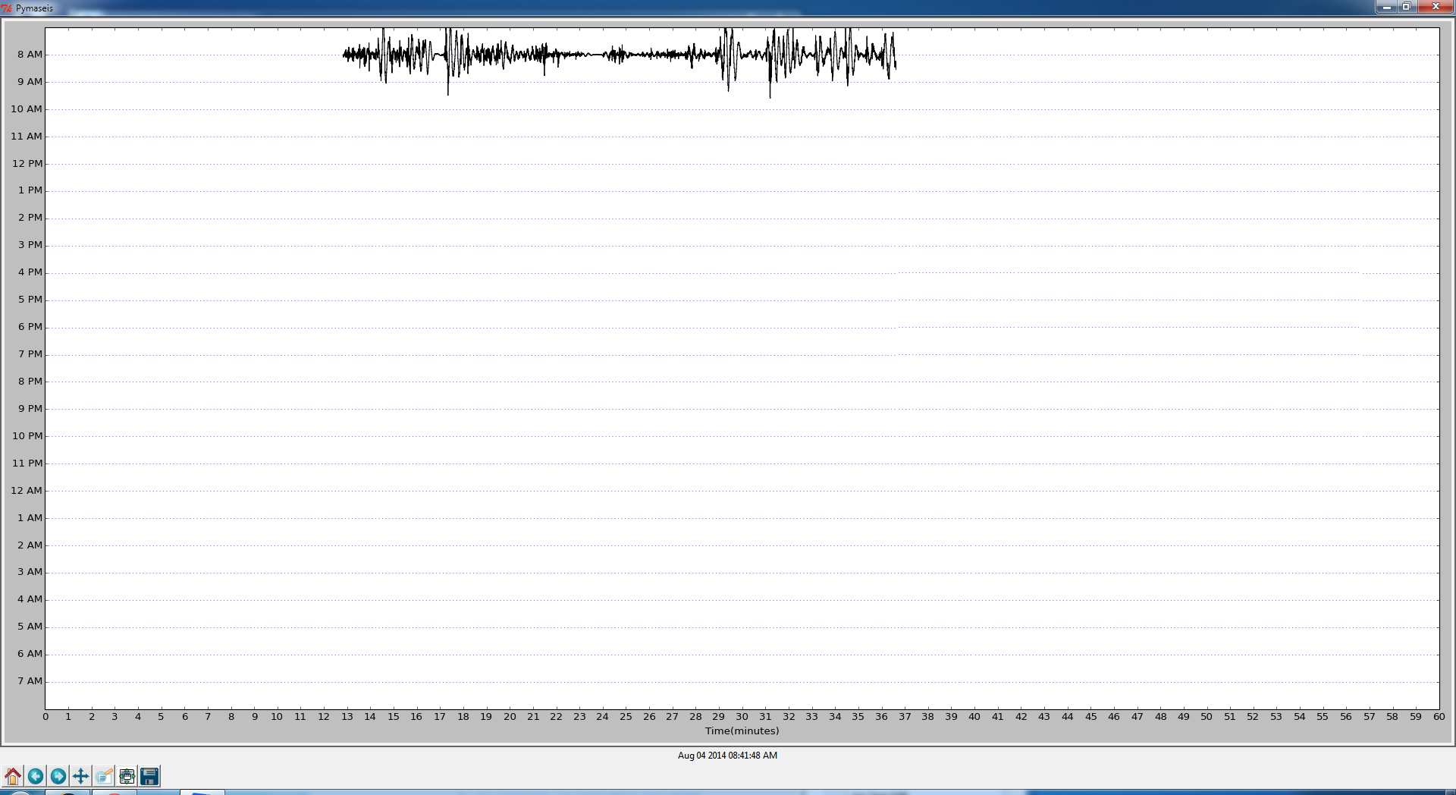
DEMO

Slide 15
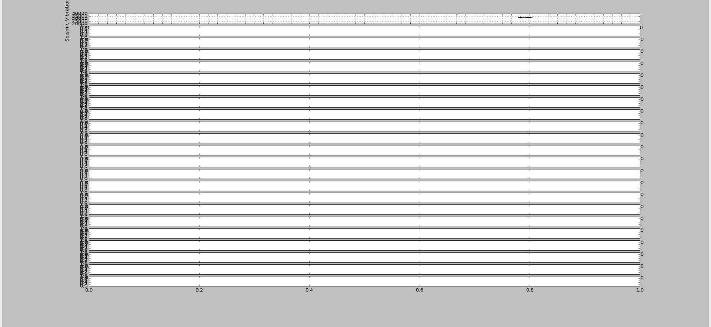
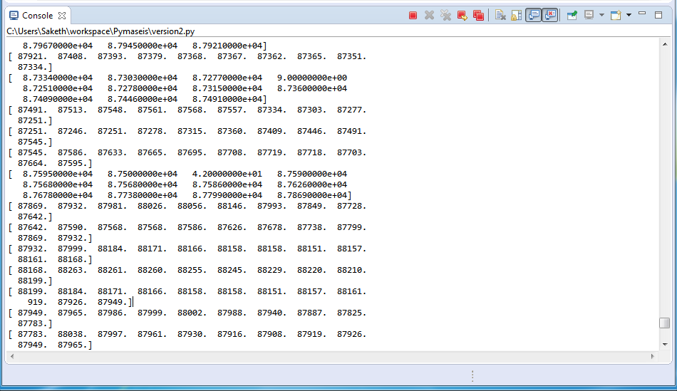
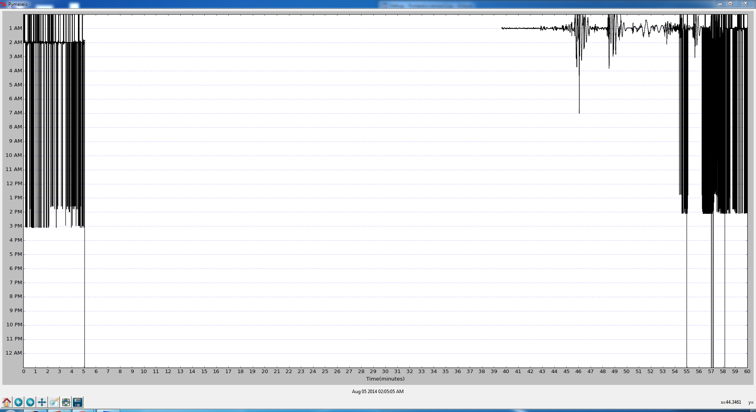
Challenges!

Slide 16
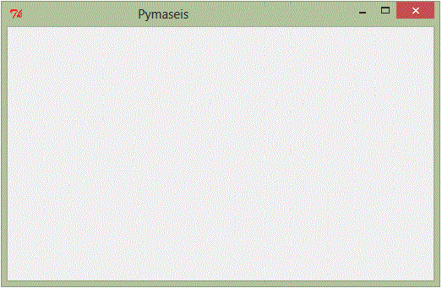
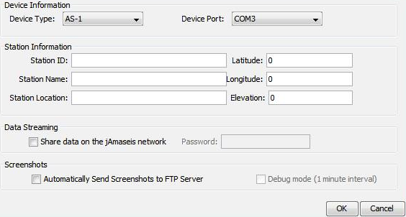
What’s Next?
Fix Existing Bugs
Saving header information
Post mseed files to Seedlink server
Post screenshots to server
Retrieve and display mseed files from Seedlink Server
Extra features
Android application that retrieves and displays screenshots

Slide 17
Thank you!
Questions?

